Slide 1
Internet Explorer 9
Performance Overview
Jason Weber
Performance Lead
Internet Explorer Team
weber@microsoft.com
http://www.ietestdrive.com
http://blogs.msdn.com/ie

Slide 2
IE9 Platform Objectives
Interoperable HTML5
  Interpret the same HTML and CSS markup the same way
  Run the same JavaScript with a consistent programming model
GPU-Powered HTML5 Graphics and Media
  HTML5 demands a high-performance graphics subsystem
  Display , SVG, Canvas, Images, Text, CSS3
Performance, Performance, Performance
  Networking, JavaScript Execution, Layout Engine, Formatting
Building the next web together!
Platform Previews and Community

Slide 3
Internet Explorer 8

Slide 4
Browser Subsystems
Networking
Layout
HTML
CSS
Collections
JavaScript
Marshalling
DOM
Formatting
Block Building
Display

Slide 5

Example Site: Wall Street Journal

Slide 6
Comparing Site Performance
Wall Street Journal
Chicago Tribune
USA Today
New York Times
Washington Post
CNN News
Seattle Times
MSN News
Financial Times
Boston Globe
News Site #1
News Site #2
News Site #3
News Site #4
News Site #5

Slide 7
Five Popular News Sites
 | Total Size | Number Elements | CSS Rules | Image Files | Script Files | Script Lines | Script Libs
News Site #1 | 3280kb | 8662 | 1293 | 137 | 21 | 14,216
News Site #2 | 961kb | 820 | 2964 | 44 | 16 | 3,812
News Site #3 | 300kb | 1187 | 1366 | 26 | 4 | 9,481
News Site #4 | 1462kb | 4257 | 893 | 76 | 21 | 11,988
News Site #5 | 2981kb | 3578 | 1917 | 88 | 19 | 20,722
JQuery
YUI
Prototype
MooTools
Scriptaculous
Other (JS Lib)

Slide 8
IE8 Subsystem Breakout

Slide 9
Average Distribution Across News Sites

Slide 10
Average Distribution Across AJAX Sites
Notes:
If you were the IE team, where would you focus?

Slide 11
Internet Explorer 9

Slide 12
Internet Explorer 9
Networking Improvements

Slide 13
Networking Performance
HTTP Caching Improvements
  Improve heuristic expiration
  Support: crazy-far-futures Expires headers
  Support: Vary: Accept-Encoding
  Support Vary: Host
  Improved scavenger
  Redirect caching
  Back/forward optimization
  Cross-domain HTTPS revalidation mitigation
Parallel Connection Improvements
  Increase connections-per-proxy to 12
  Speculatively pre-open additional connection
  Improved LCIE connection limiting
DNS Improvements
  Pre-fetch based on Link Rel=Prefetch
  Pre-fetch based on likely matches in ULV flyout
  Pre-fetch addresses based on previous use
  Fast-path for IP literals
General Improvements
  Shorter User Agent String
  Gracefully handle codepage restarts
  Autoproxy in the frame
  Img src=”” shouldn’t send a request
  Issue requests on the wire earlier
  Only download requires files (fonts)

Slide 14
PLT2: Bytes Downloaded

Slide 15
Internet Explorer 9
New JavaScript Engine & Compiler

Slide 16
Interpreters, Compilers, Intermediary Languages, Machine Code, Stack Alignment, JIT, Type System, Registers, Memory Management, Assembly, Bytecode, Tracing, Syntax Trees, Dynamic Languages, Flow Analysis, Static Languages, Regular Expressions, Inlining, oh my…

Slide 17
New JavaScript Interpreter
Foreground
Source Code
Parser
AST
Byte Code
Interpreter
Notes:
Type System
Libraries

Slide 18

Multi-Core Processing
Multi-Core CPU

Slide 19
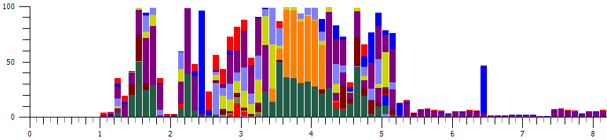
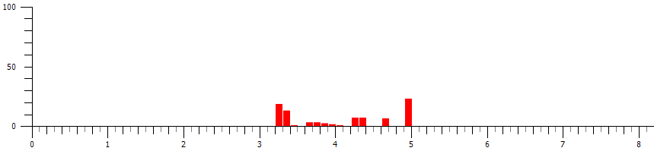
IE8 Processor Distribution
Foreground
Background

Slide 20
Windows Experience Index Results
Month | CPU Count
6/1/2010 | 2.42
Windows Experience Index
Number of CPU Cores for Vista and Win7 Users

Slide 21
JavaScript Background Compiler
Foreground
Source Code
Parser
AST
ByteCode
Interpreter
Background
Background Compiler
Native Code

Slide 22
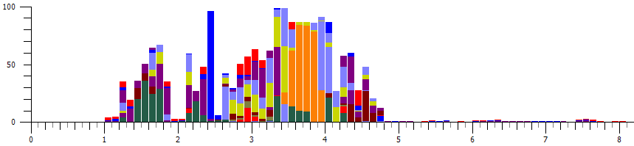
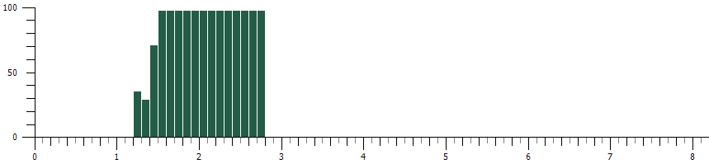
IE9 Background Compilation
Foreground
Background

Slide 23
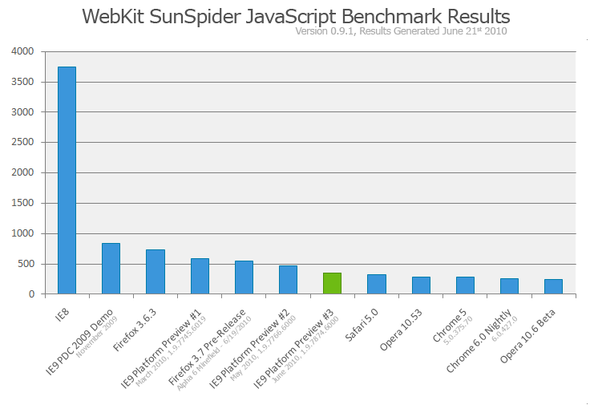
WebKit SunSpider Results

Slide 24
Web Application API Usage

Slide 25
Internet Explorer 9
GPU Powered Graphics

Slide 26
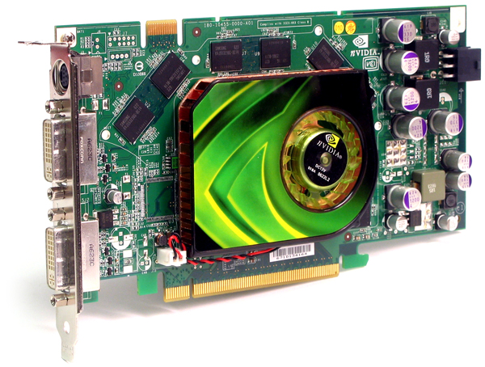
The Gamers GPU

Slide 27

Everyone Has a GPU

Slide 28

GPU Processing Performance
Multi-Core CPU
GPU

Slide 29
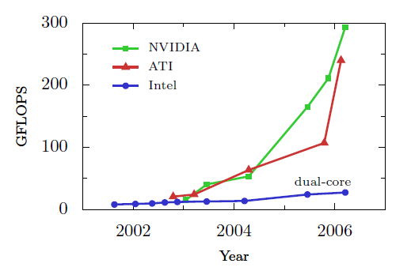
Exponential Growth in GPU Power
John D. Owens, David Luebke, Naga Govindaraju, Mark Harris, Jens Krüger, Aaron E. Lefohn, and Tim Purcell. A Survey of General-Purpose Computation on Graphics Hardware. Computer Graphics Forum, 26(1):80–113, March 2007. We acknowledge Computer Graphics Forum, Eurographics (The European Association for Computer Graphics) and Blackwell Publishing.

Slide 30
Windows Experience Index - GPU
4% 15% 32% 27% 12% 10%
1 2 3 4 5 6 7 8
Windows Experience Index
Graphics Scores of Vista and Win7 Users

Slide 31
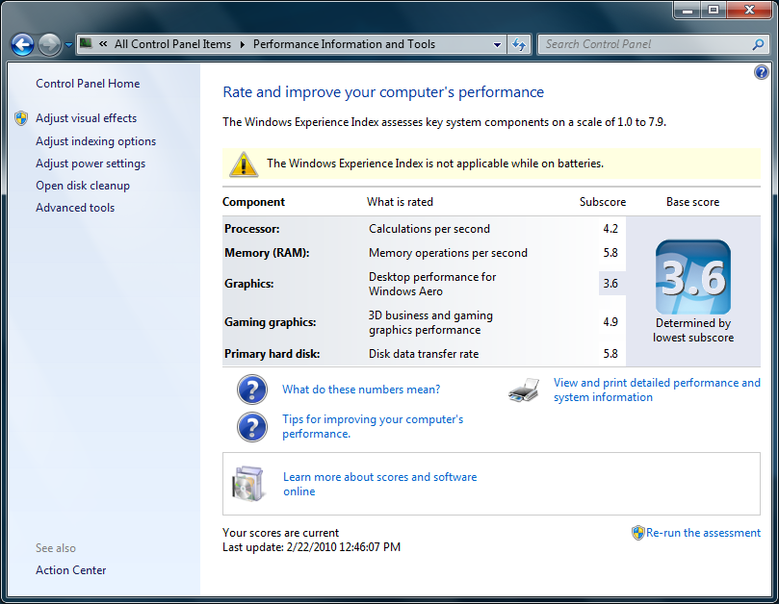
My Laptop WEI Score

Slide 32
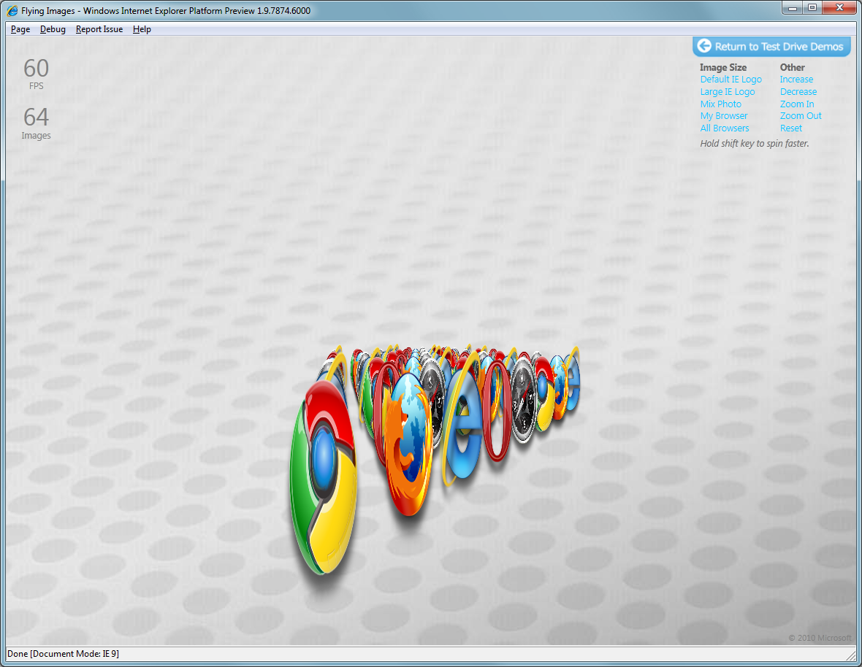
GPU Powered Graphics

Slide 33
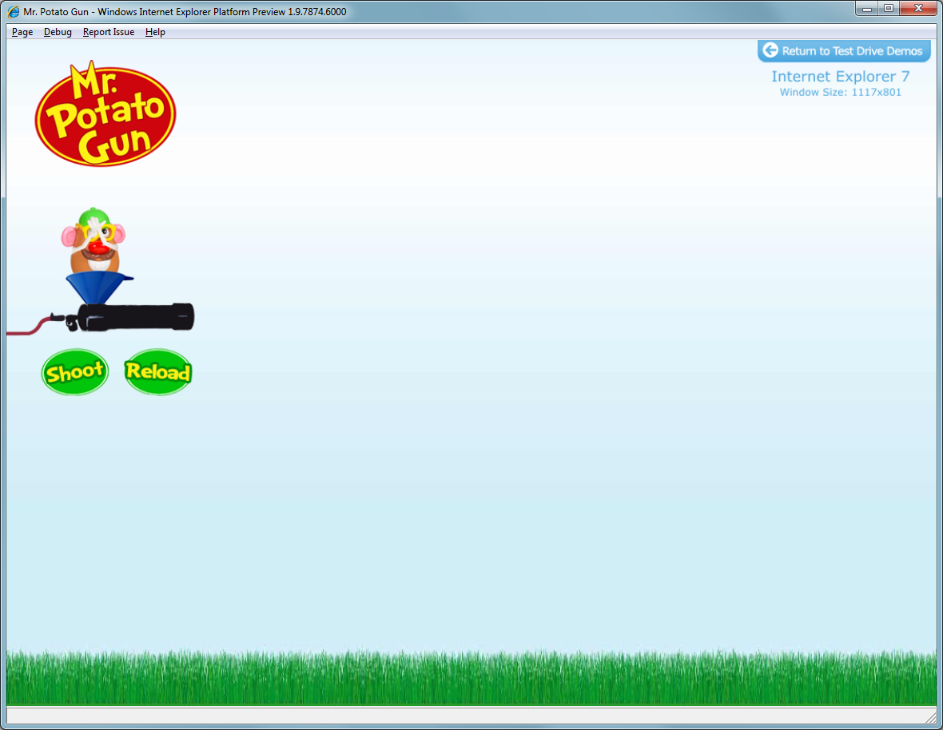
GPU Powered Canvas

Slide 34
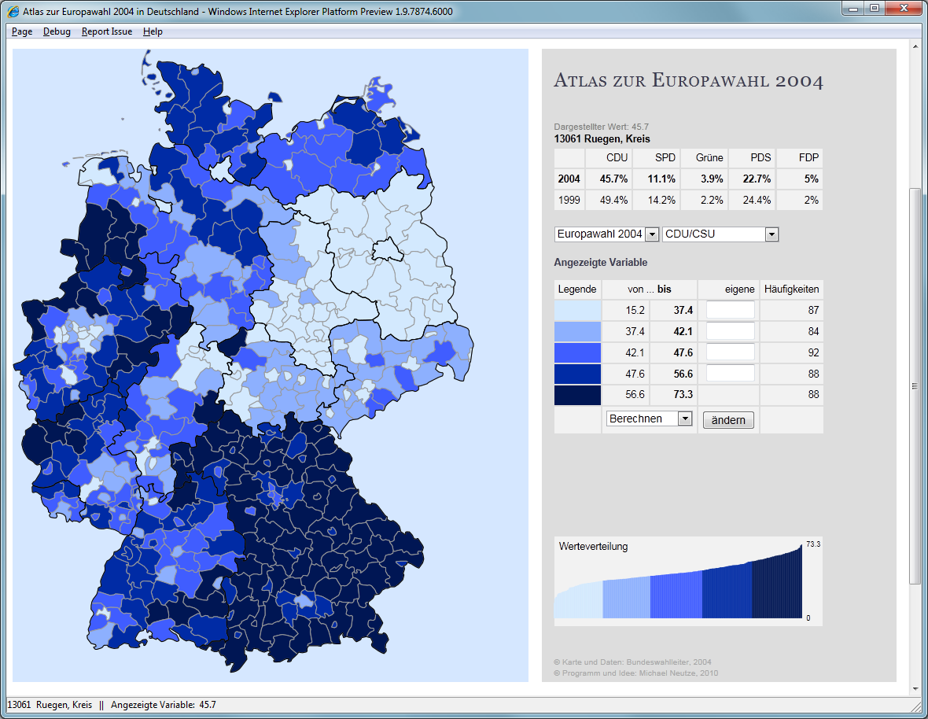
GPU Powered SVG

Slide 35
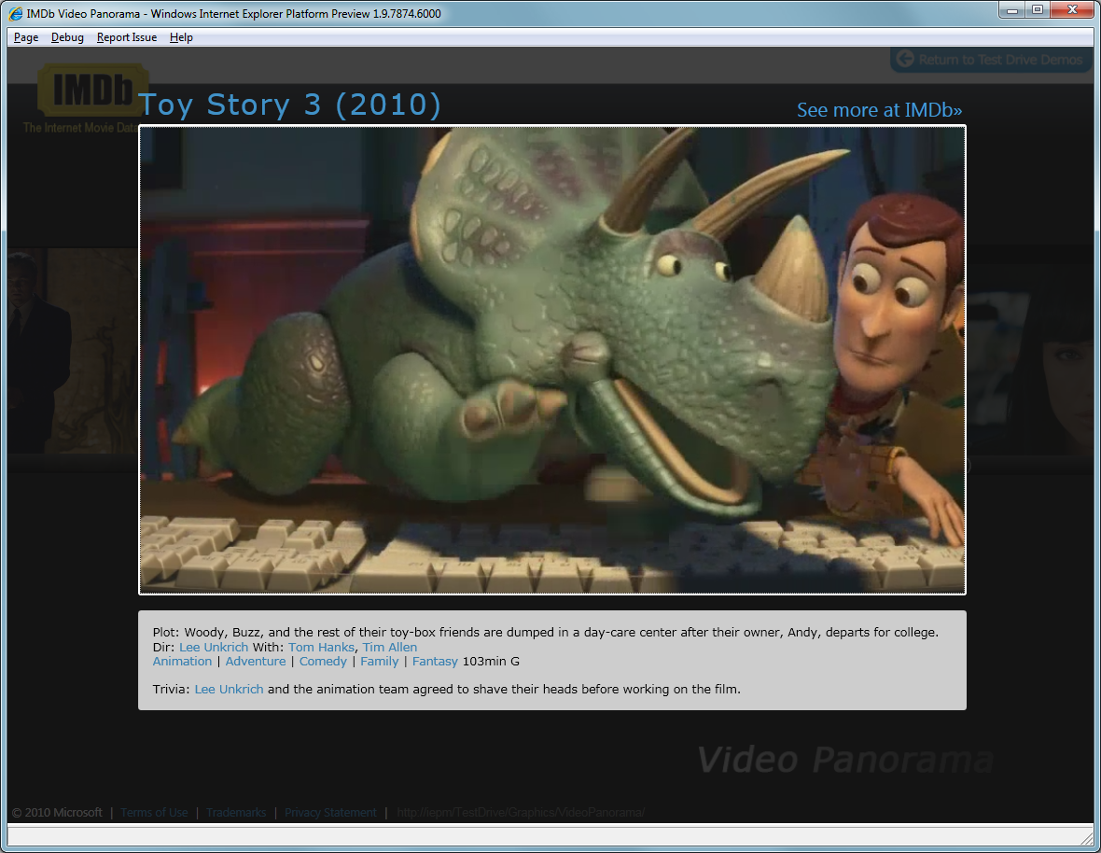
GPU Powered Video

Slide 36

GPU Powered Text

Slide 37
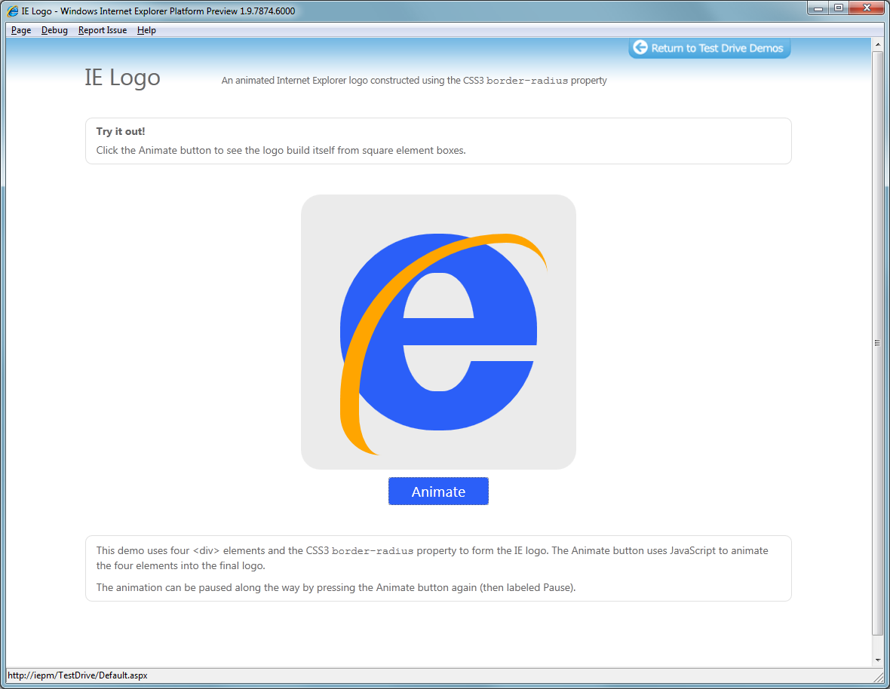
GPU Powered CSS3

Slide 38
Behind the Scenes
Compiled JavaScript
GPU Powered Graphics

Slide 39
Demo: Flying Images

Slide 40
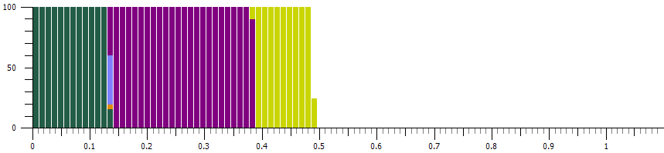
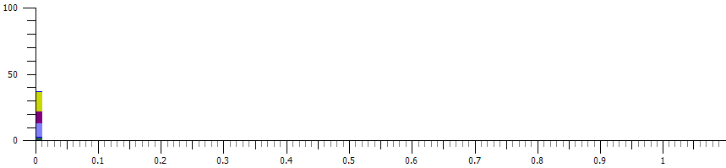
Flying Images – One Animation
IE8
IE9

Slide 41
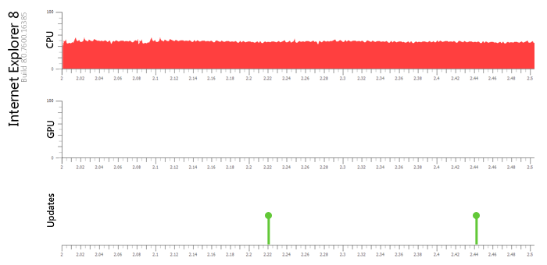
IE8 Hardware Usage

Slide 42
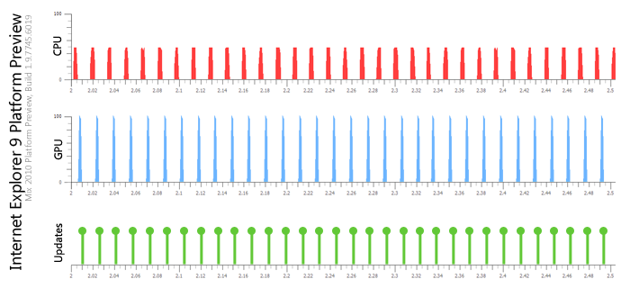
IE9 Hardware Usage

Slide 43
Measuring Performance

Slide 44
Performance Metrics Today
<html>
<head>
<script type="text/javascript">
var start = (new Date).getTime();
</script>
</head>
<body>
<script type="text/javascript">
var pageLoad = (new Date).getTime() - start;
</script>
</body>
<img src="http://www.site.com/beacon.png" />
</html>

Slide 45
Performance Metrics Tomorrow
// after page is loaded
var pageLoad = window.timing.timingMeasures.navigation;
// get access to all the timing information:
JSON.Stringify(window.msPerformance);

Slide 46
Demo: Web Timings

Slide 47
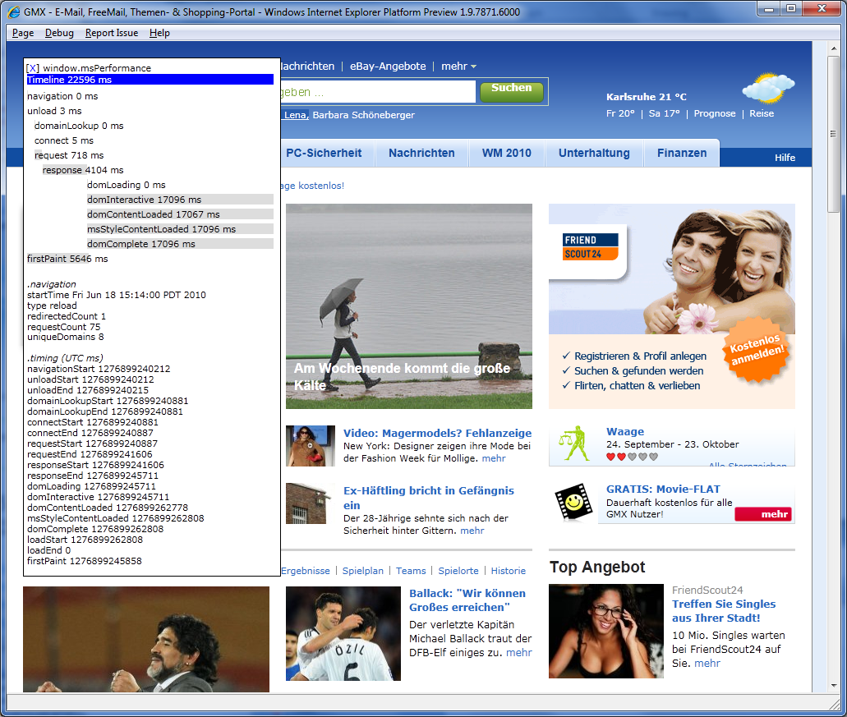
Try it out and send feedback…

Slide 48
IE9 is Fundamentally Different

